Slide 1
Excelr Data Science Project For Oil Price Prediction
Group no.3:-
Mr. Chaitanya Digambar Ingle
Mr. Shubham Shashikant Palkar
Mr. Madugundu Sai Kumar
Ms. Sakshi Deshmukh
Mr . Sudeep P
Mr. Shubham Vijay Rangate

Slide 2
Xyz company acquired the following data of oil prices changes occurred daily, Make a model to predict the prices for months/dates to help the customers to get the price hike and decrease in prices to invest in particular stocks
PROBLEM STATEMENT

Slide 3
Steps for Forecasting
Importing
04
Select model building method
01
Acquiring data by webs-crapping then importing it
Data driven approaches, and other model building methods
02
05
Model Evaluation & hyperparameter tuning
EDA
Sorting, dealing with null values, duplicates, outliers
Evaluating the model doing hyperparameter tuning by checking RMSE values
03
Train the model
06
Deployment
Splitting data for train test and some
Deployment of model

Slide 4
Importing of data
Web-scrapping
Importing in Jupyter notebook
Loading site into Octoparse
Selecting the data to be imported
Exporting it as excel file
By using pandas library importing the data into notebook

Slide 5
EDA
Null & Duplicate values
Checking for null and duplicates and describing the data
Some EDA processes
Sorting
Dropping the unwanted columns and declaring the index column
Outliers
Detecting the outliers by plotting graphs (line,hist,box,lag,kde), and deal with outliers
Stationary data
After dealing with outliers we transform our data into stationary data

Slide 6
Splitting the data
Train
Test
80% data
20% data

Slide 7
1) Forecasting model based : In order to check for past pattern will follow to future we tried for model driven approach for this we extracted necessary column from data like logprice,t squared and built the available model driven models and get the lower rmse for additive seasonality.

Slide 8
02
01
Additive Seasonality
Model Based Method
Linear Model
03
04
Exponential
Add Sea with Quadratic Trend
05
07
06
Quadratic
Multiplicative Additive Seasonality
Multiplicative Season

Slide 9
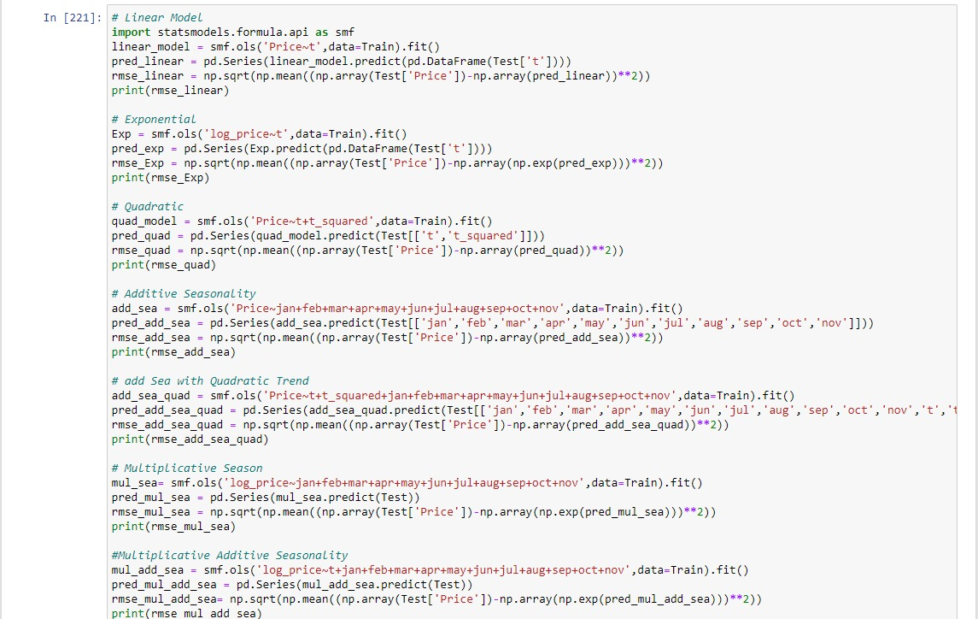

Slide 10
2) Data Driven Models :To pick the best smoothing value for smoothing techniques we performed hyperparmeter tuning and after selecting the best value of 0.1 we performed all data driven. Models and checked their rmse values

Slide 11
Data Driven Method
Hyperparameter Tuning
Holts winter exponential smoothing with multiplicative seasonality and additive trend
05
Holts winter exponential smoothing with additive seasonality and additive trend
04
Holt Method
03
Simple Exponential Smoothing
02
01
Smoothing level

Slide 12
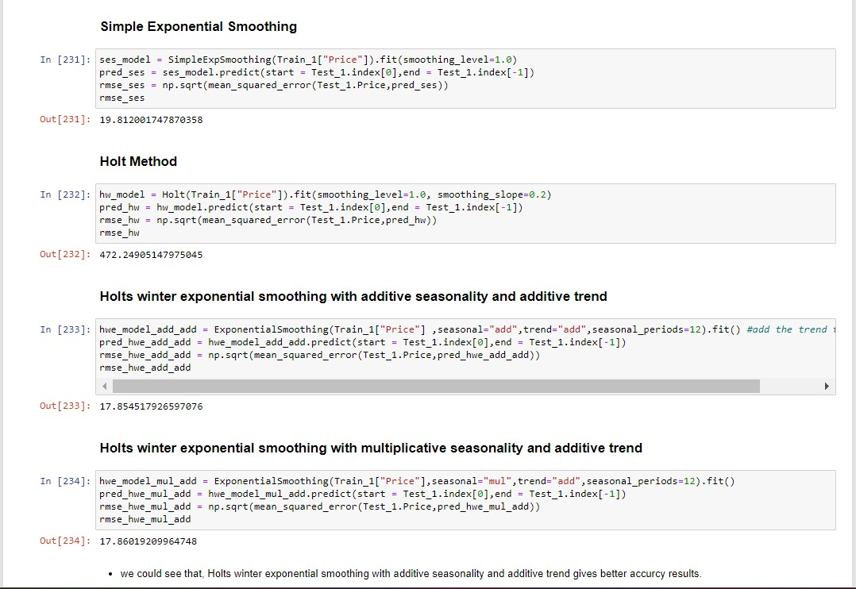

Slide 13
Data Driven models Imp Algorithms
01
ARIMA
ARIMA Hyperparameter Tuning
02
AI
System configuration
03
SARIMA
SARIMA Hyperparameter Tuning
04
05
PROPHET
PROPHET Evaluation
06
07
LSTM
LSTM Evaluation
08

Slide 14
3)Fitting auto ARIMA: Plot the acf and pacf plot to check the correlation . In next, to pick the best p,d,q values we fit the data into auto arima and selected best pdq values i,e (2,1,2) Later on based on those values we performed arima and achieved rmse of 19.8
4) SARIMA : A SARIMA model uses differencing at a lag equal to the number of seasons to remove additive seasonal effects. As we are dealing with daily data, so we can try on monthly seasonality i.e. 30 days but we can still found some residuals which are not acceptable so we calculated the best P,D,Q values by hyperparameters and train the model on seasonal ARIMA. we got the rmse of 20.35.

Slide 15
5) Prophet: In FB prophet model we have to rename the column name for prophet model understanding and we just fitted prophet model on our dataset and we evaluated model performance by using rmse metric.
6) lstm: kind of recurrent neural network that is capable of learning long term dependencies in data. This simple model has a single LSTM layer followed by an FC layer. We compile the model with the Mean Squared Error loss function and an Adam Optimiser. We trained this compiled model on the generated data with 50 epochs and batch size of 32. After training the model, we can use the evaluate function to perform a batch evaluation on the test dataset. The model performs pretty decently which is giving the rmse 0.0159 which is least of all the trained models in whole model evaluation.

Slide 16
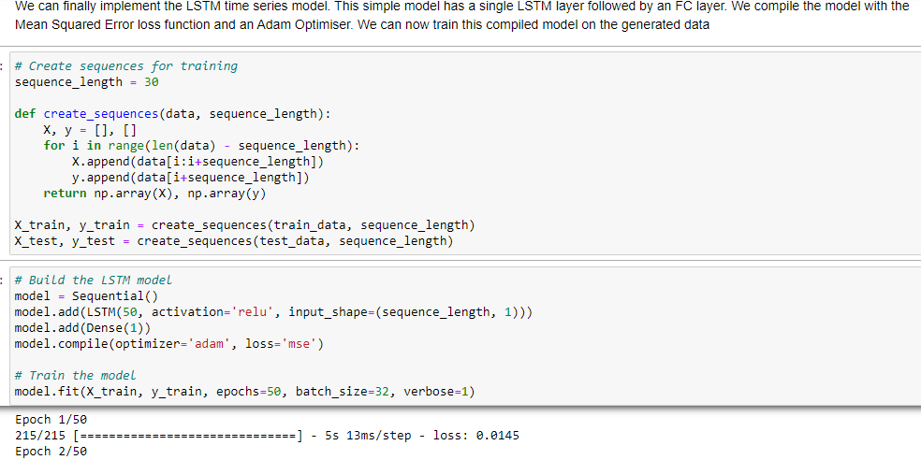
Long Short-Term Memory (LSTM) is a type of Recurrent Neural Network that is specifically designed to handle sequential data. The LSTM RNN model addresses the issue of vanishing gradients in traditional Recurrent Neural Networks by introducing memory cells and gates to control the flow of information and a unique architecture.

Slide 17
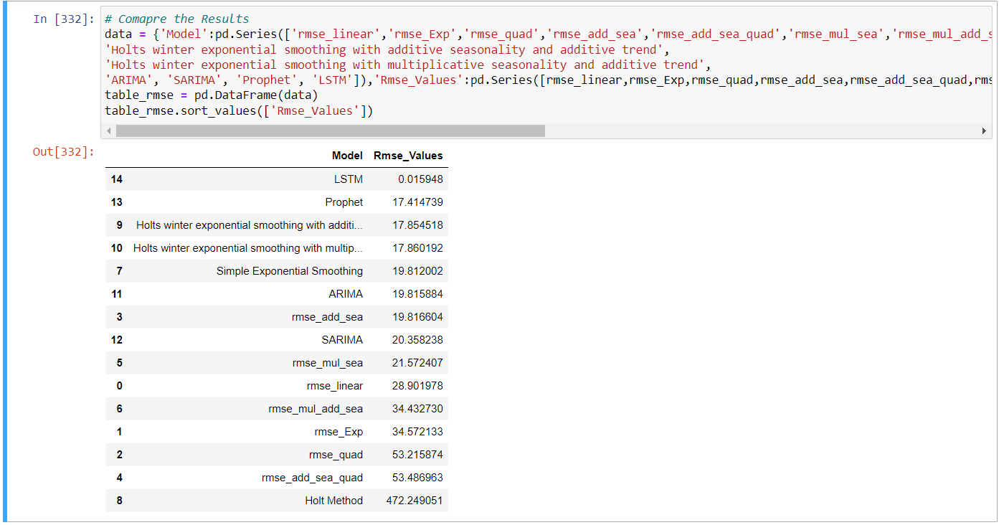
Comparing the models

Slide 18
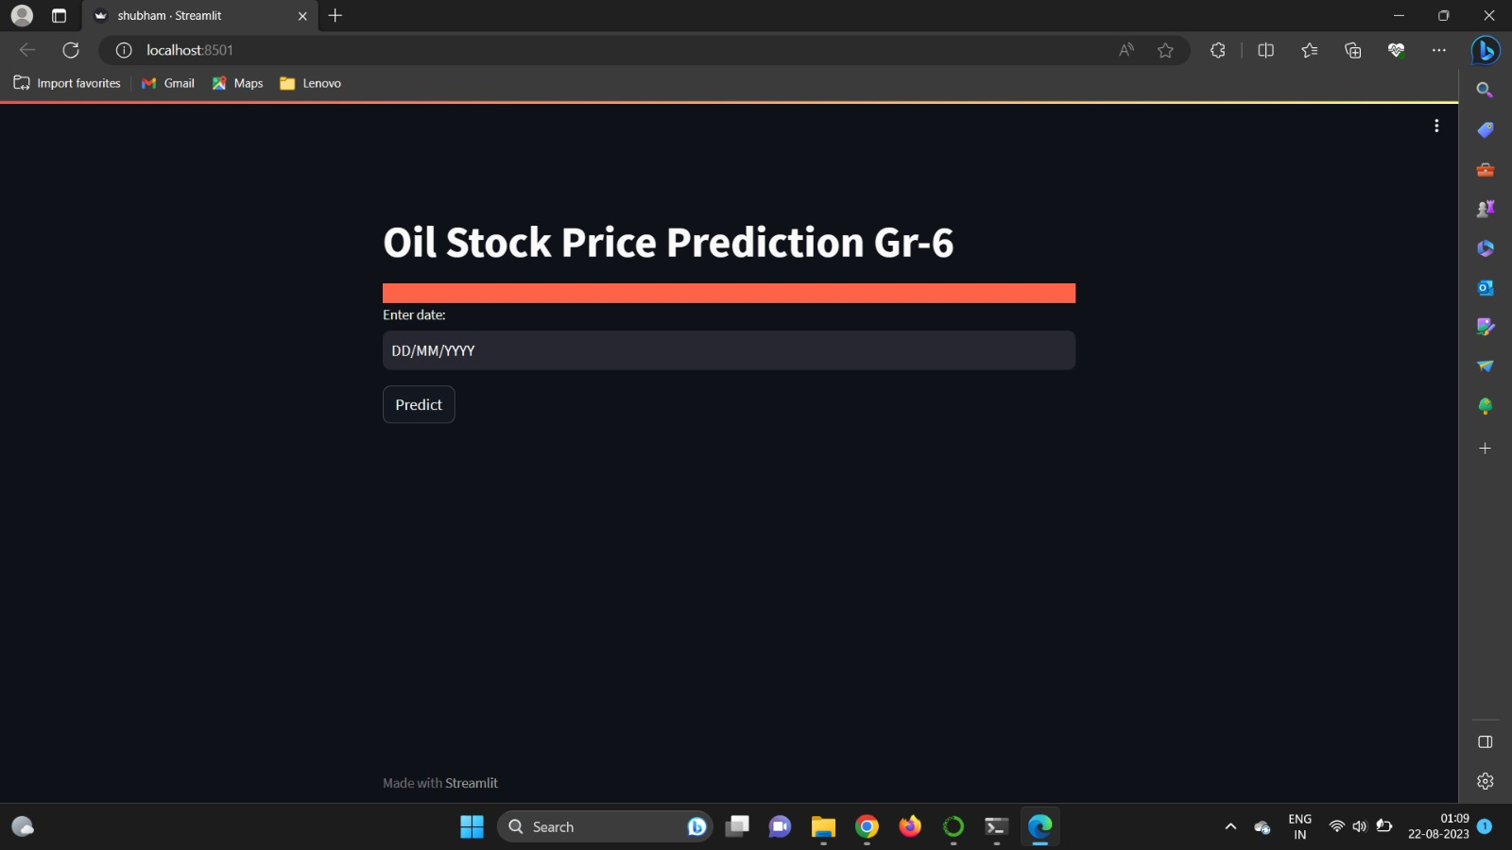
Deployment
Libraries used
import keras.models
import numpy as np
import pandas as pd
import streamlit as st
import joblib
import pickle
from sklearn.preprocessing import MinMaxScaler
from keras.layers import Dense
from keras.layers import Input, LSTM
from keras.models import Model
import h5py
from datetime import timedelta, date
We imported the LSTM model and used it for price prediction.
For deployment we used streamlit and keras

